Slide 1
Movie Genre Predictor
Monica Ravichandran, Kalyan Vejalla

Slide 2
Features Used
Synopsis
Plot Keywords
Top 16 Poster Colors

Slide 3
11 Classes:
Action | Crime
Adventure | Drama
Romance | Thriller
War | Comedy
Sci-Fi | Horror
Western

Slide 4
Synopsis Intro
Word Cloud - displays the most occuring words in each genre
Bar Chart - shows the comparison to the rest of the genres

Slide 5
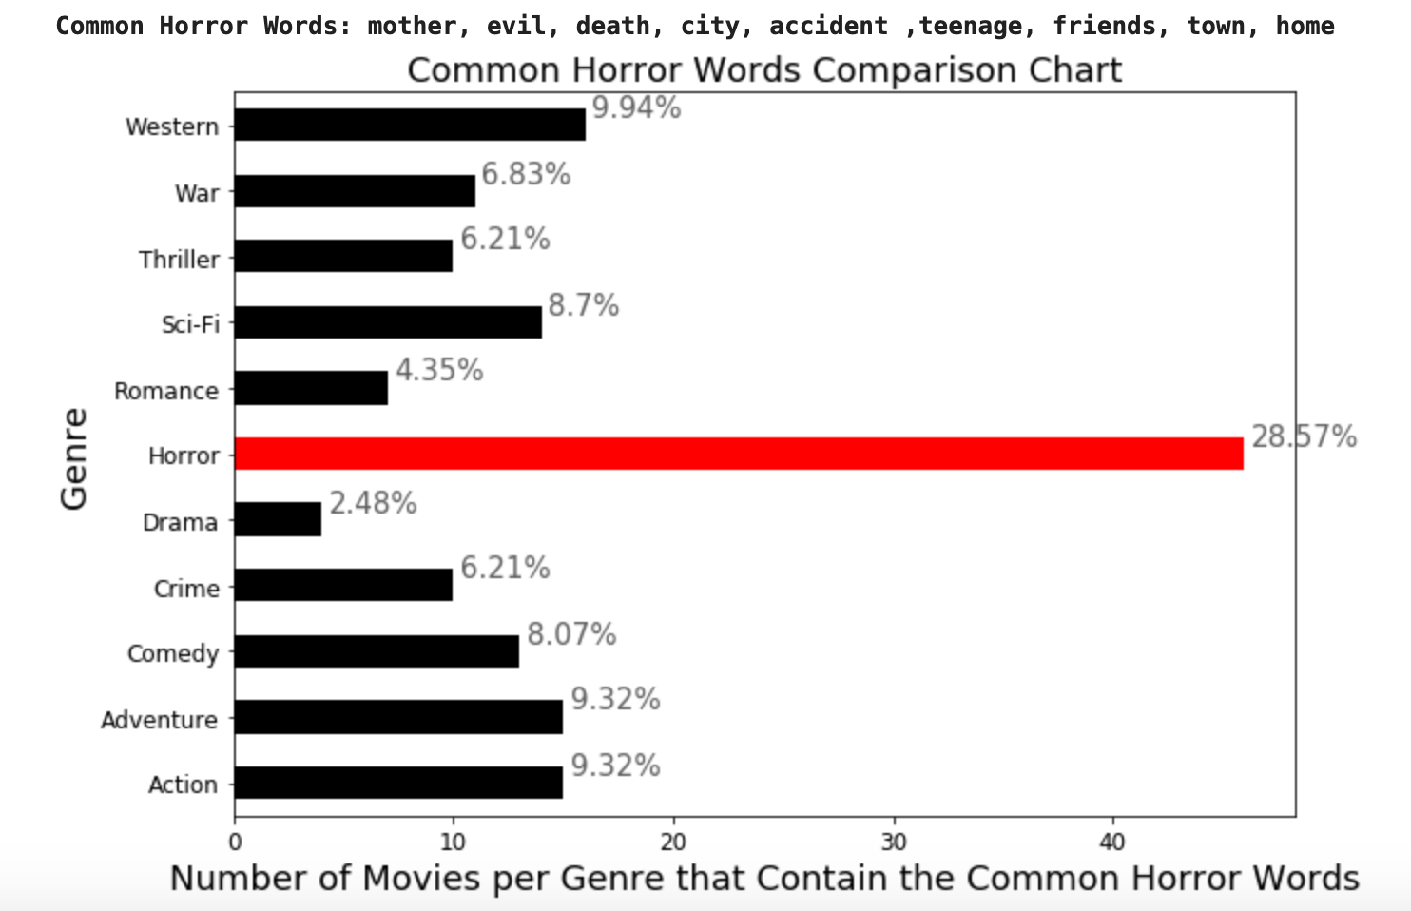
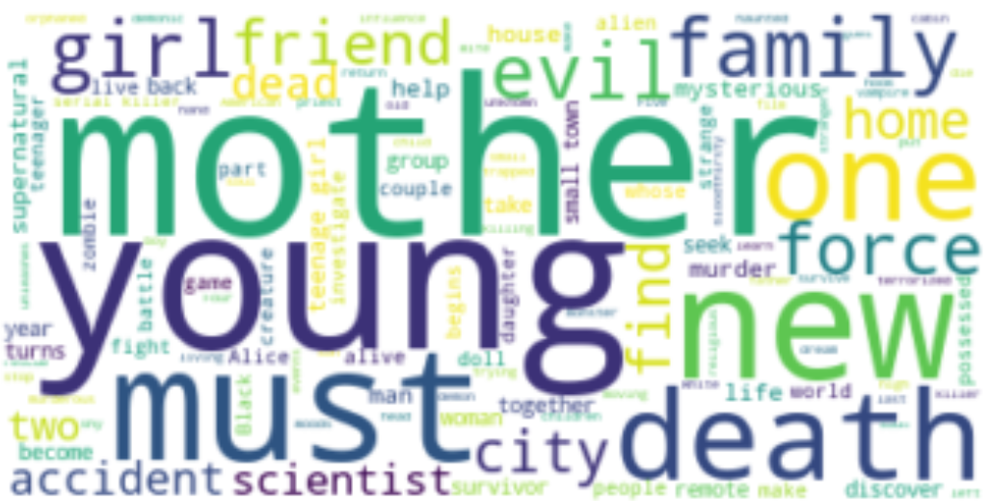
Synopsis Analysis
Horror
%’s represent the percentage of the common horror words that occur in each genre

Slide 6
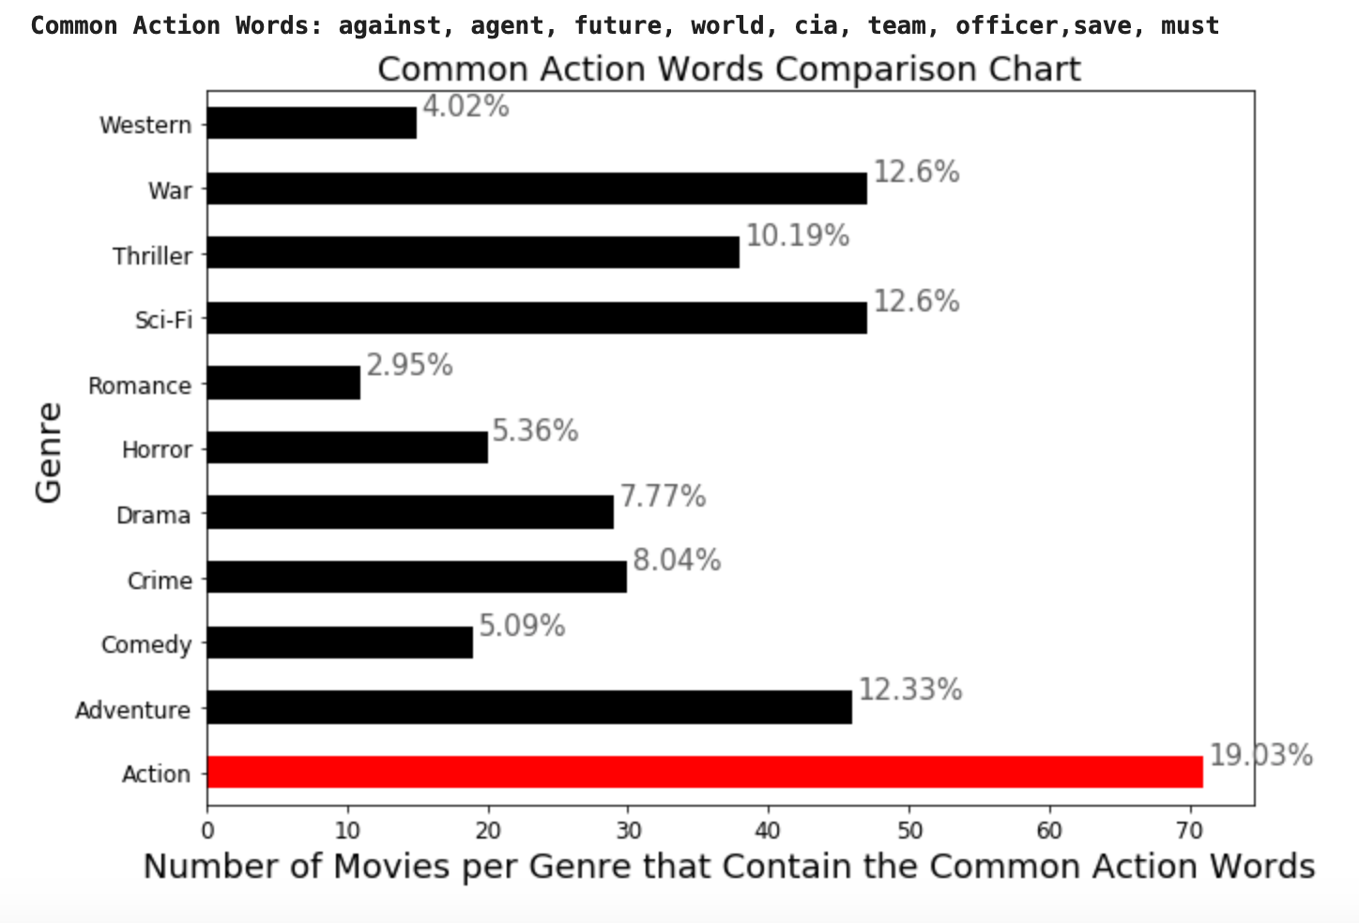
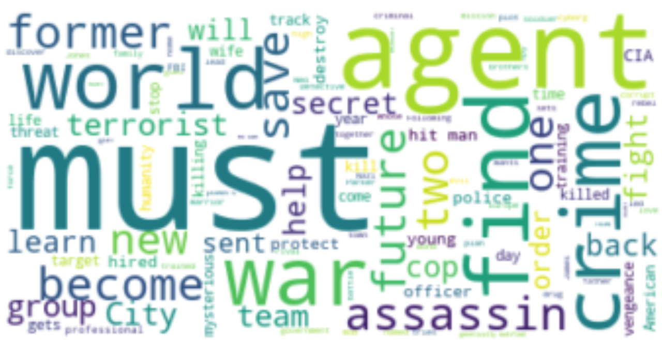
Synopsis Analysis
Action
%’s represent the percentage of the common action words that occur in each genre

Slide 7
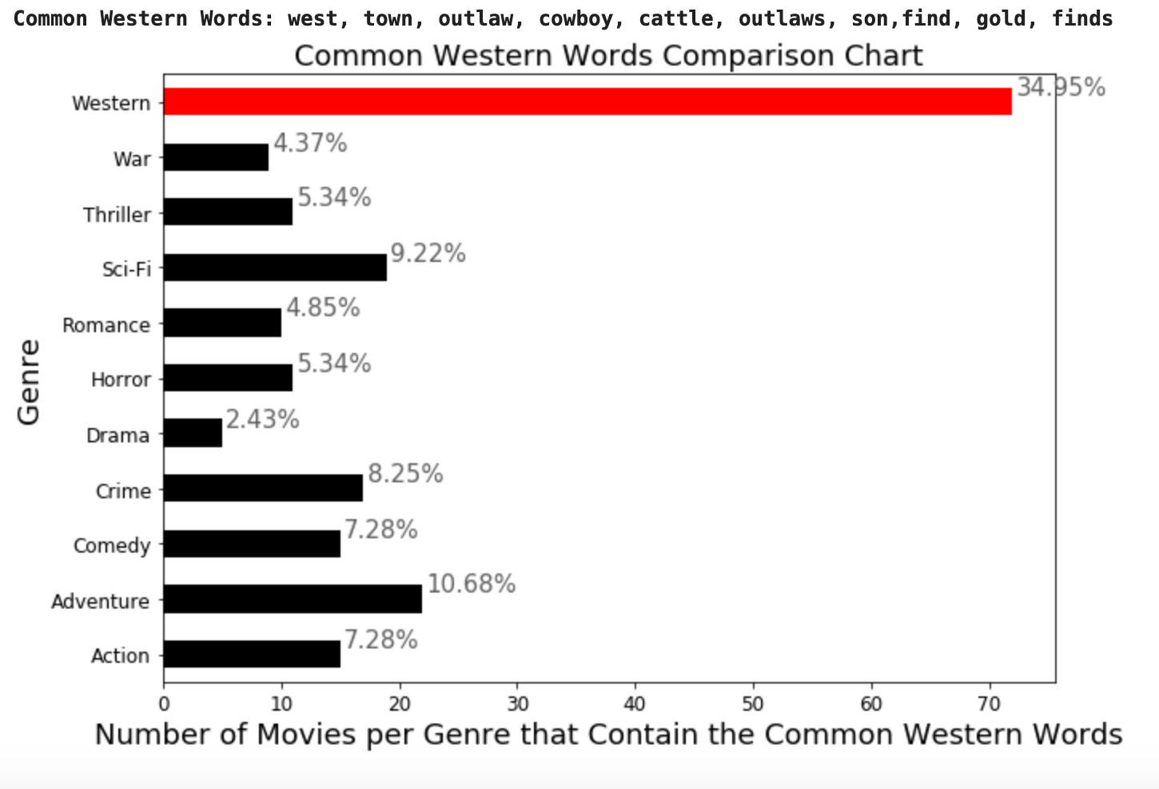
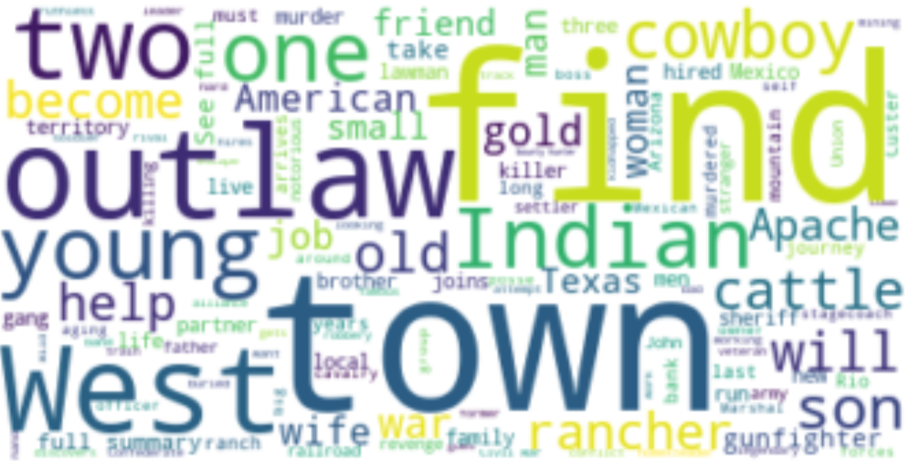
Synopsis Analysis
Western
%’s represent the percentage of the common western words that occur in each genre

Slide 8
Synopsis Analysis
By looking at the percentages, we can see that there were no other movies that had words too similar to the main genres. The bar charts for Drama and Thriller both show that the other genres have similar words to Drama and Thriller. Lastly, the Romance and Comedy were tied in the Romance bar chart.
We can conclude that each genre has common words in their synopsis and there is a correlation between the words that occur in the synopsis and the movie genre.
This means that Synopsis is a good feature to use for our machine learning model.

Slide 9
Plot Keywords Intro
Plot keywords identified by IMDb per movie
Bar Chart - shows the comparison

Slide 10
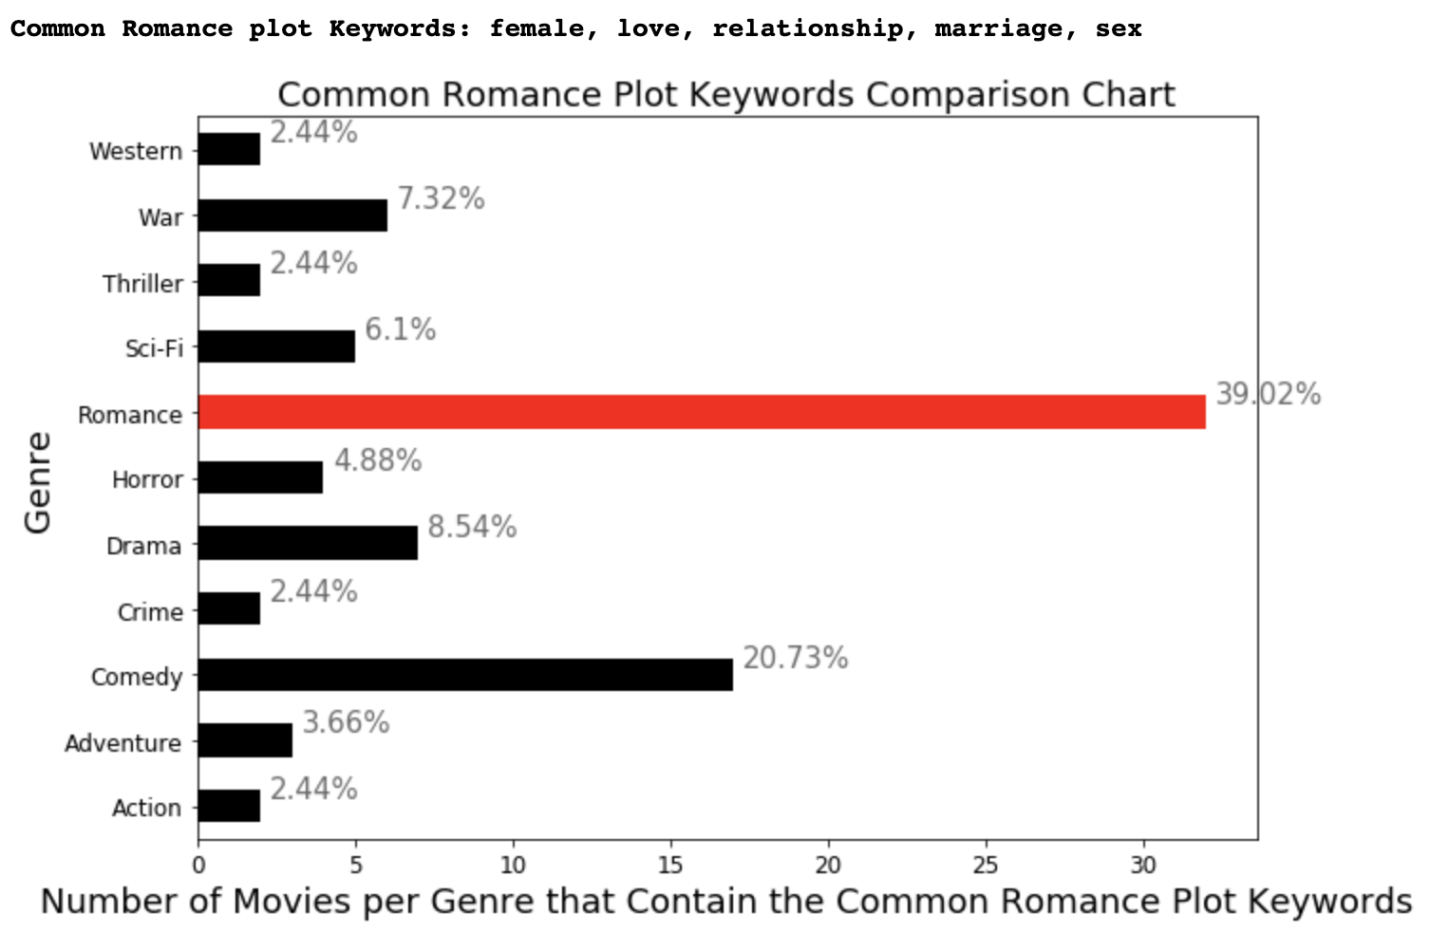
Plot Keywords Analysis

Slide 11
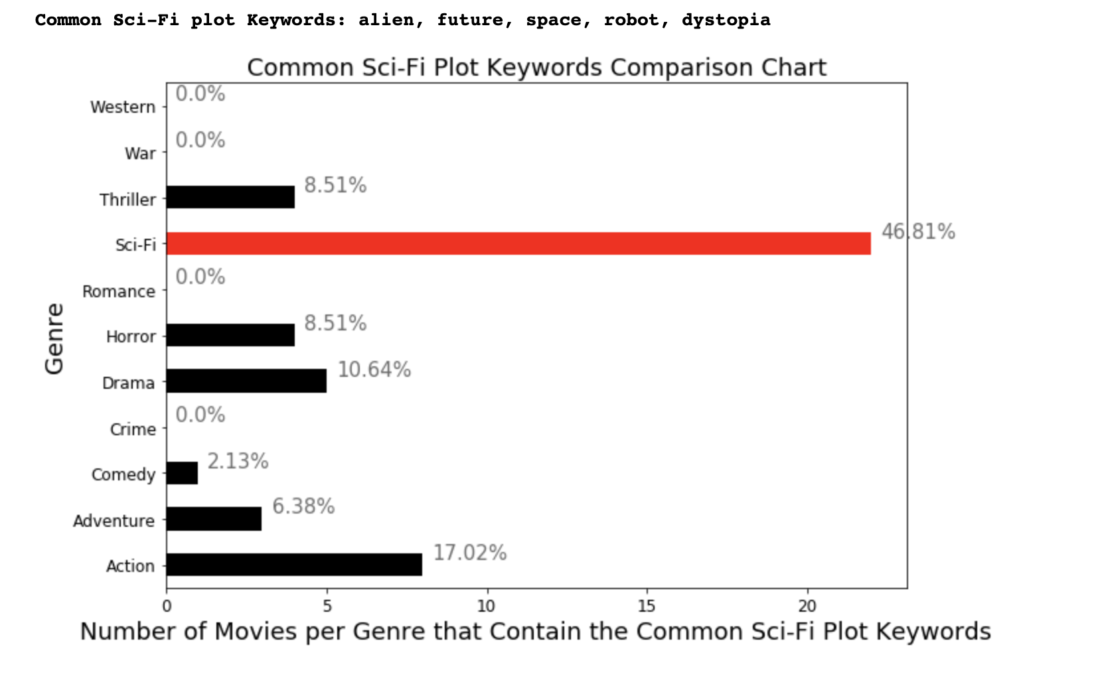
Plot Keywords Analysis

Slide 12
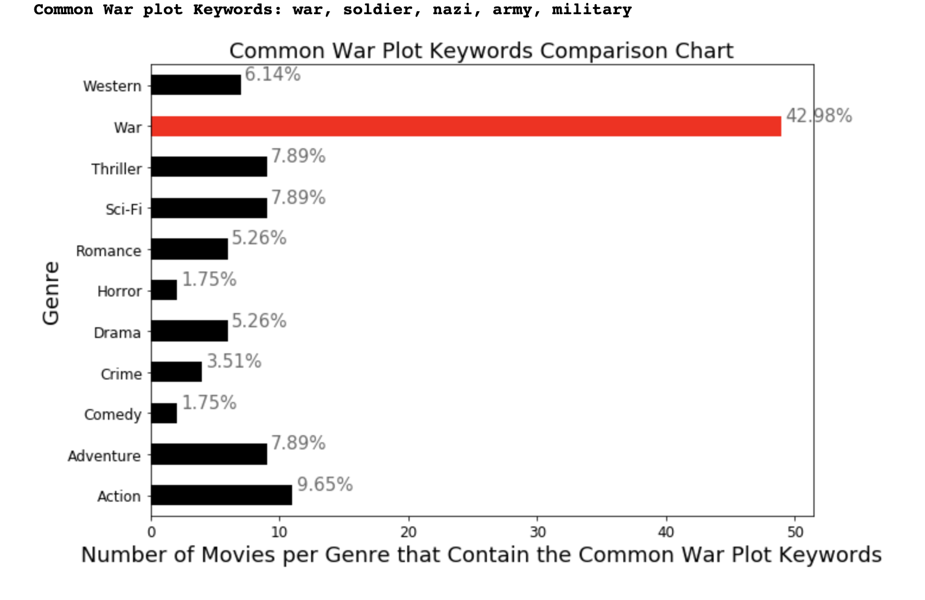
Plot Keywords Analysis

Slide 13
Plot Keywords Analysis
We can conclude that each genre has common words in their Plot Keywords and there is a relation between the Plot Keywords and Movie genre.
This is because each genre has a common list of words that occur mostly only in that genre’s plot keywords.
This means that Plot Keywords is a good feature to use for our machine learning model.

Slide 14
Poster Color Intro
Collected all the pixels into an array for a certain genre
Ran Kmeans with 16 clusters to get the top 16 colors per genre by weight
Created a color palette with the first box being the top color, second box representing the second top color, …

Slide 15
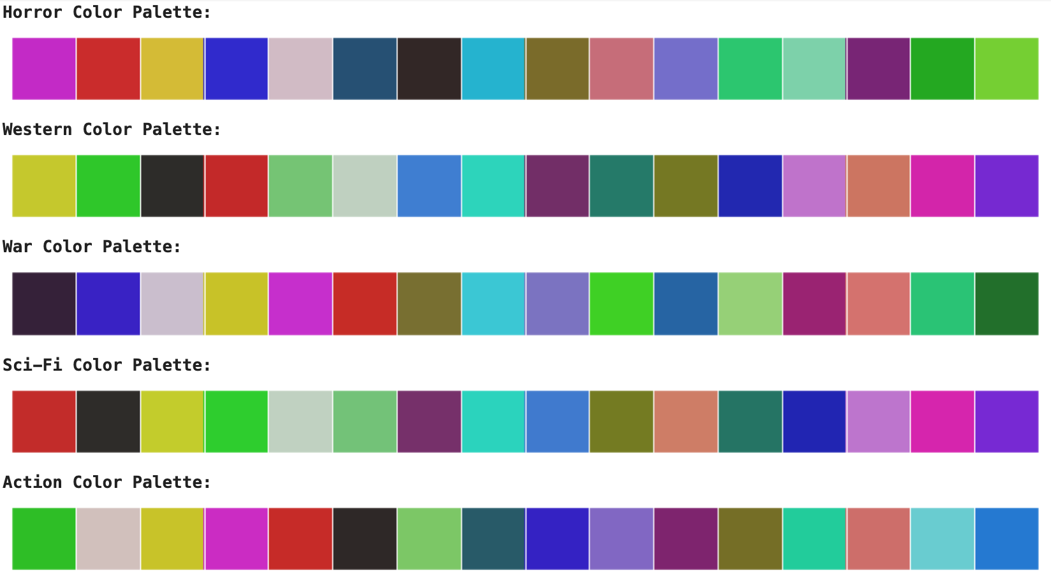
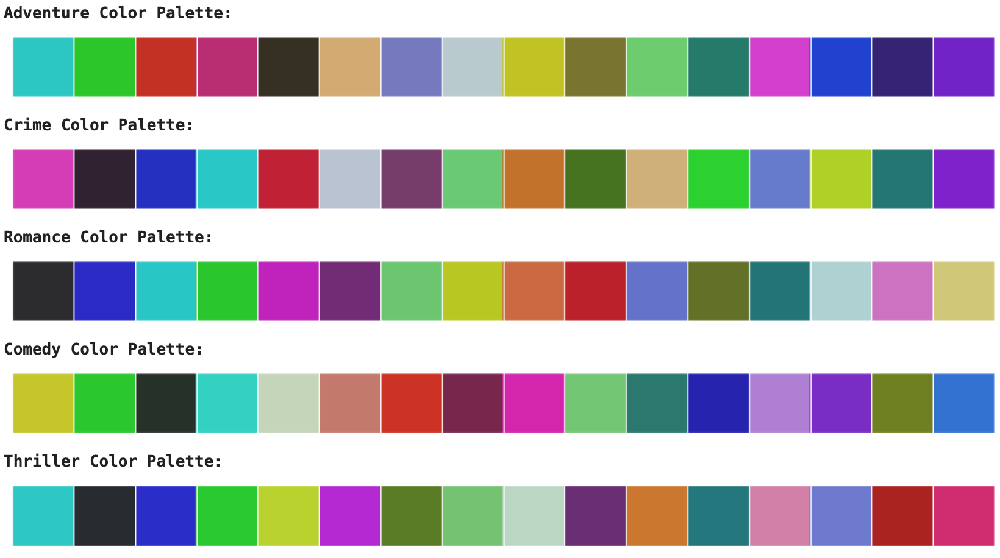
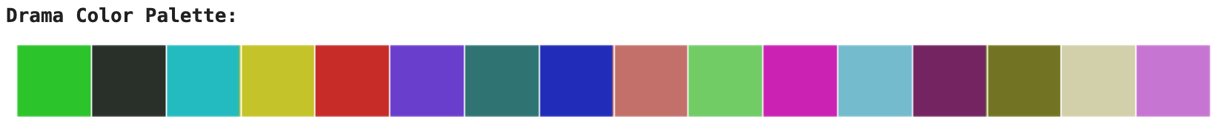
Poster Color Analysis

Slide 16
Poster Color Analysis
According to the palettes above we can see that the top 16 colors when sorted by the weights (how prominent the color is in each genre), are approximately the same across all of the genres. This means that there is, apparently, only a weak correlation between the poster colors and the genre.
But, numbers are more promising than just looking at colors. So, in ML_2, we still build a model using poster colors as features to predict movie genre and we analyze it. The goal is to potentially include this model in the ensembler model with other models using synopsis text and keywords text as features if it yields the best results.

Slide 17
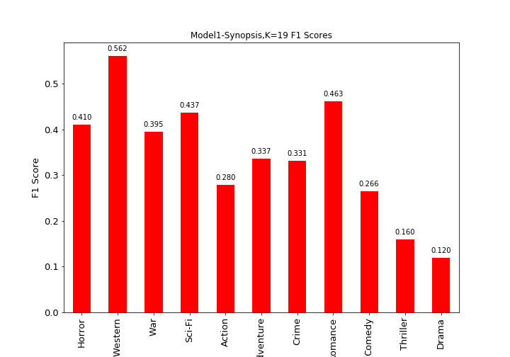
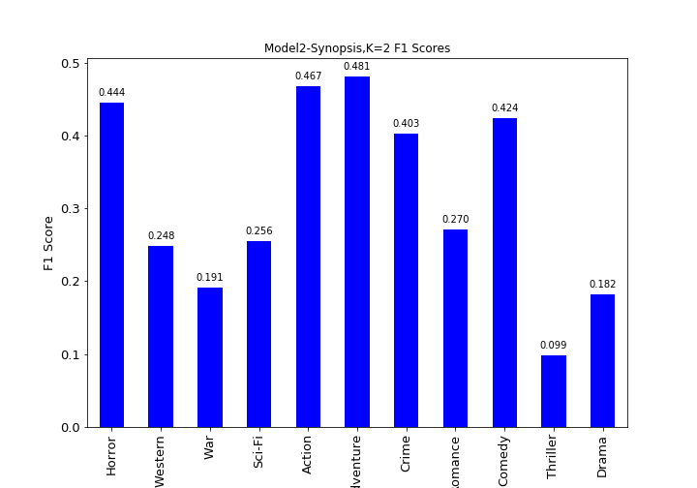
Machine Learning Models Created
ML Model 1:
Features: Synopsis, K = 19, Accuracy = 49.5%
ML Model 2:
Features: Synopsis, K = 2 Accuracy = 53.5%
Analysis: According to the two models above, both performed decently well, but model 2 performed better in classes where model 1 did not and vice versa. Therefore we decided to make an ensemble out of these two models.

Slide 18
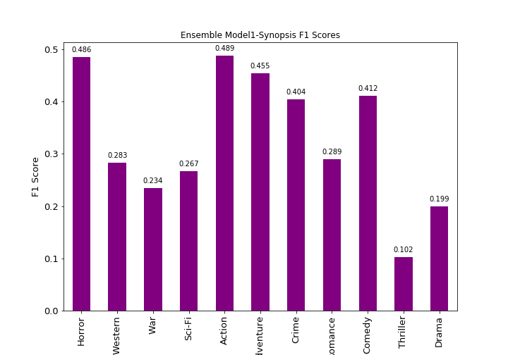
Ensemble Model 1
Accuracy = 54.8%
Ensembler of two models : Model 1 and Model 2
Ensemble method : Ensembled by picking class with best probability across the 2 models

Slide 19
ML Model 3:
Features: Synopsis, Plot Keywords, K = 6, Accuracy = 53.5%
Ensemble Model 1:
Features: Synopsis, Accuracy = 54.8%
+
=
Ensemble Model 2.1:
Ensemble method : Ensemble by picking class with best probability across the 3 models
Accuracy = 55.9%
Ensemble Model 2.2:
Ensemble method : Ensemble by picking class with highest vote among the predictions of the 3 models
Accuracy = 49.4%
Ensemble Model 2.3:
Ensemble method : Ensembler that takes average of the probabilities of all 3 models and picks the class with the highest average probability
Accuracy: 56.2%
Best Model so Far: Ensemble Model 2.3

Slide 20
ML Model 4:
Features: Top 16 Poster Colors, K = 2, Accuracy = 36.3%
Ensemble Model 2.3:
Features: Synopsis, Plot KeyWords, Accuracy = 56.2%
+
=
Ensemble Model 3.1:
Ensemble method : Ensemble by picking class with best probability across the 3 models
Accuracy = 54.3%
Ensemble Model 3.2:
Ensemble method : Ensemble by picking class with highest vote among the predictions of the 3 models
Accuracy = 43.5%
Ensemble Model 3.3:
Ensemble method : Ensembler that takes average of the probabilities of all 3 models and picks the class with the highest average probability
Accuracy: 54.2%
Best Model so Far: Still Ensemble Model 2.3

Slide 21
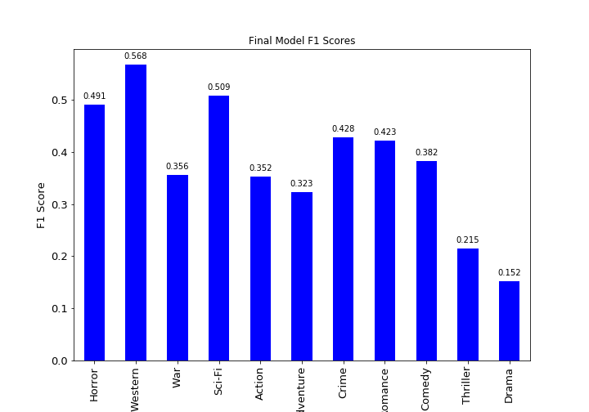
Final Machine Learning Model Result - Ensemble Model 2.3
Features Used:
Synopsis,
Plot Keywords
Accuracy: 56.2%

Slide 22
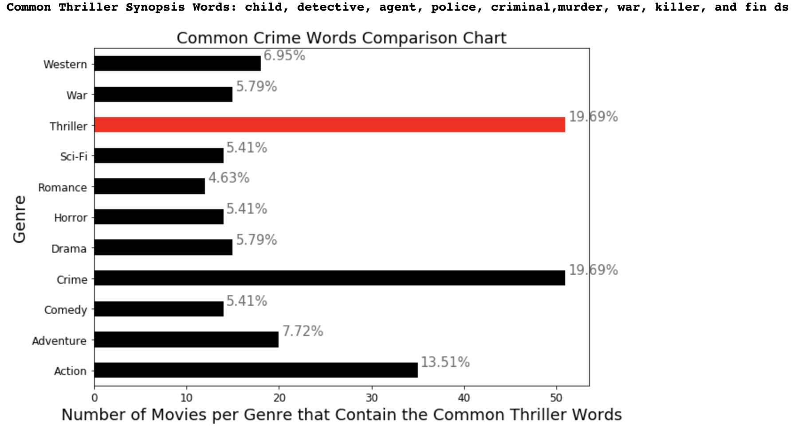
Ensemble Model 2.3 Conclusions - Thriller
Thriller did not perform well
In the bar chart, thriller is tied to crime. So, it may mispredict.
That is why our model does not do well on thriller.

Slide 23
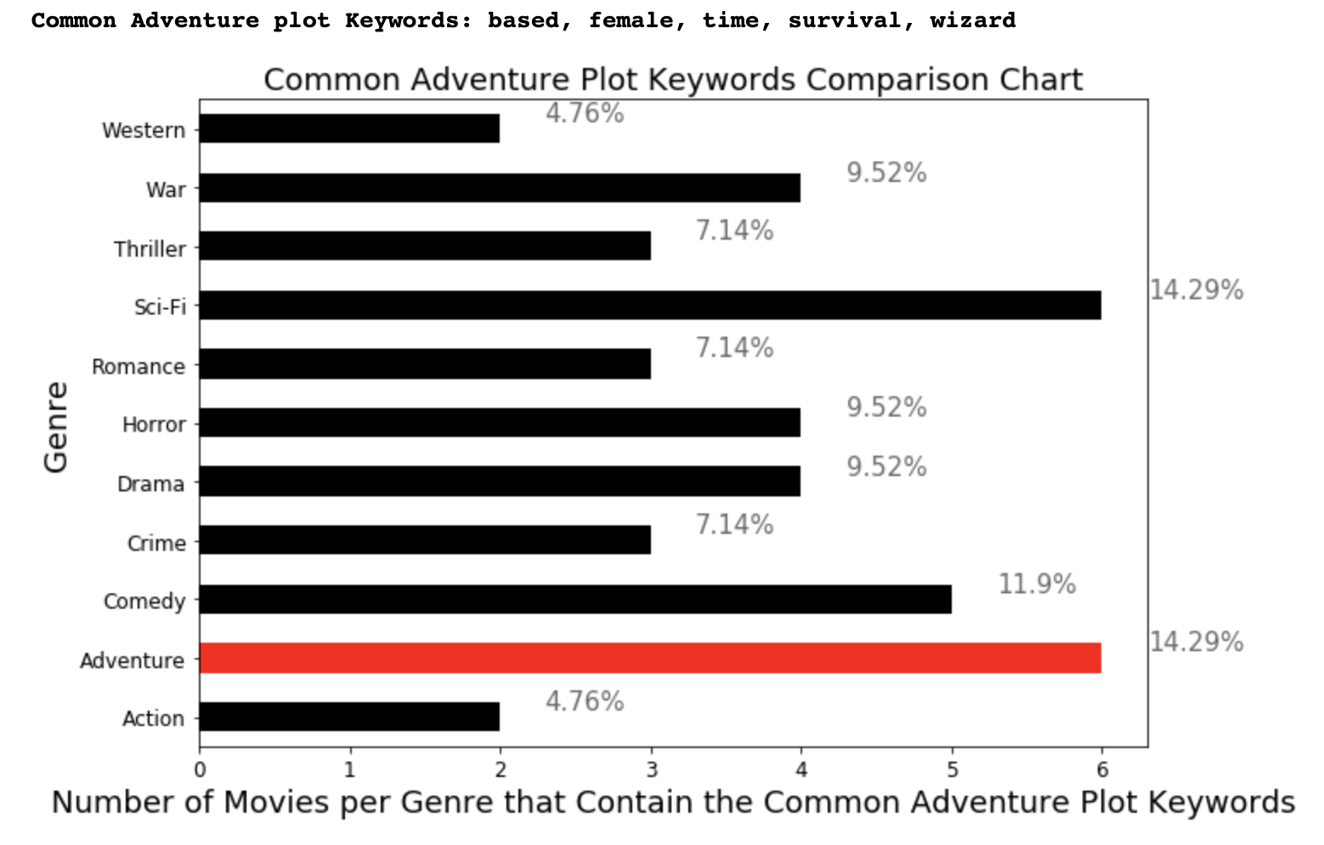
Ensemble Model 2.3 Conclusions - Adventure
Adventure did not perform well
In the bar chart, adventure is tied to sci-fi. So, it may mispredict.
That is why our model does not do well on adventure.

Slide 24
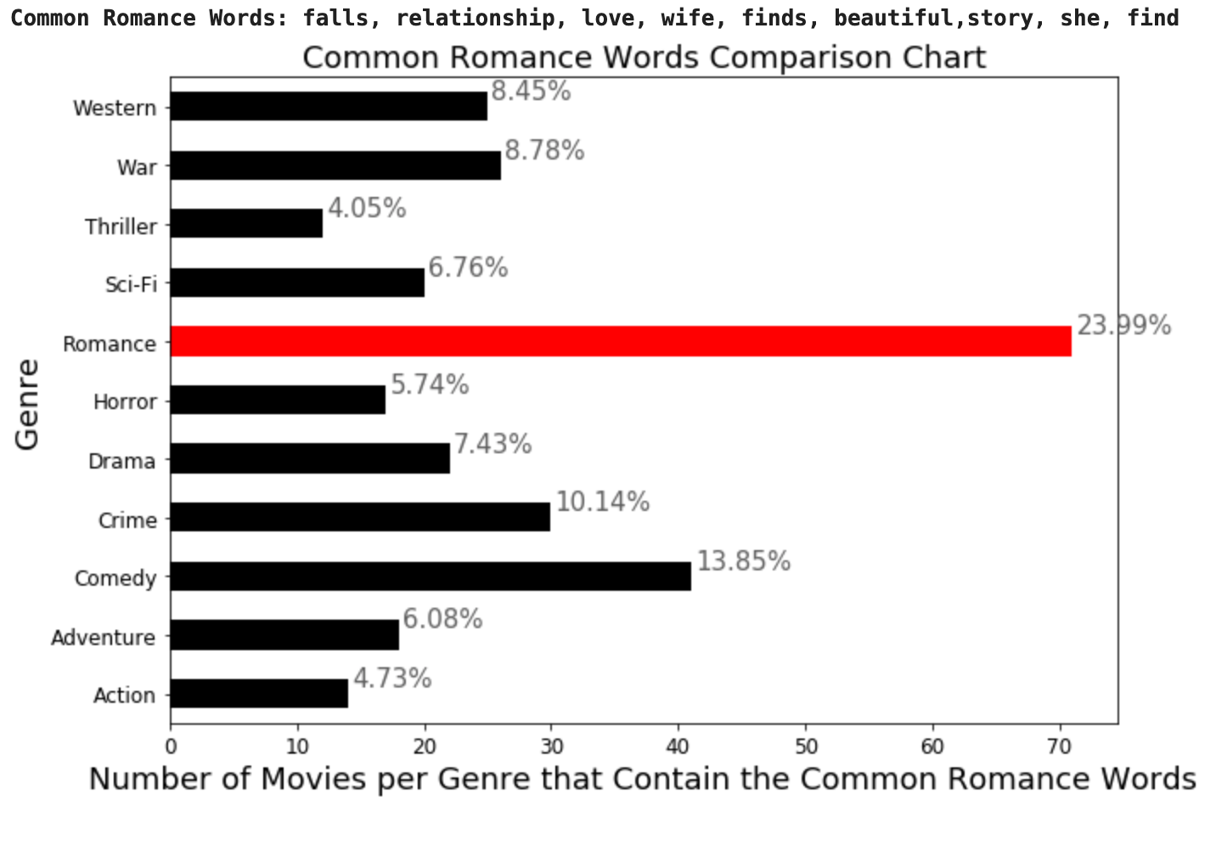
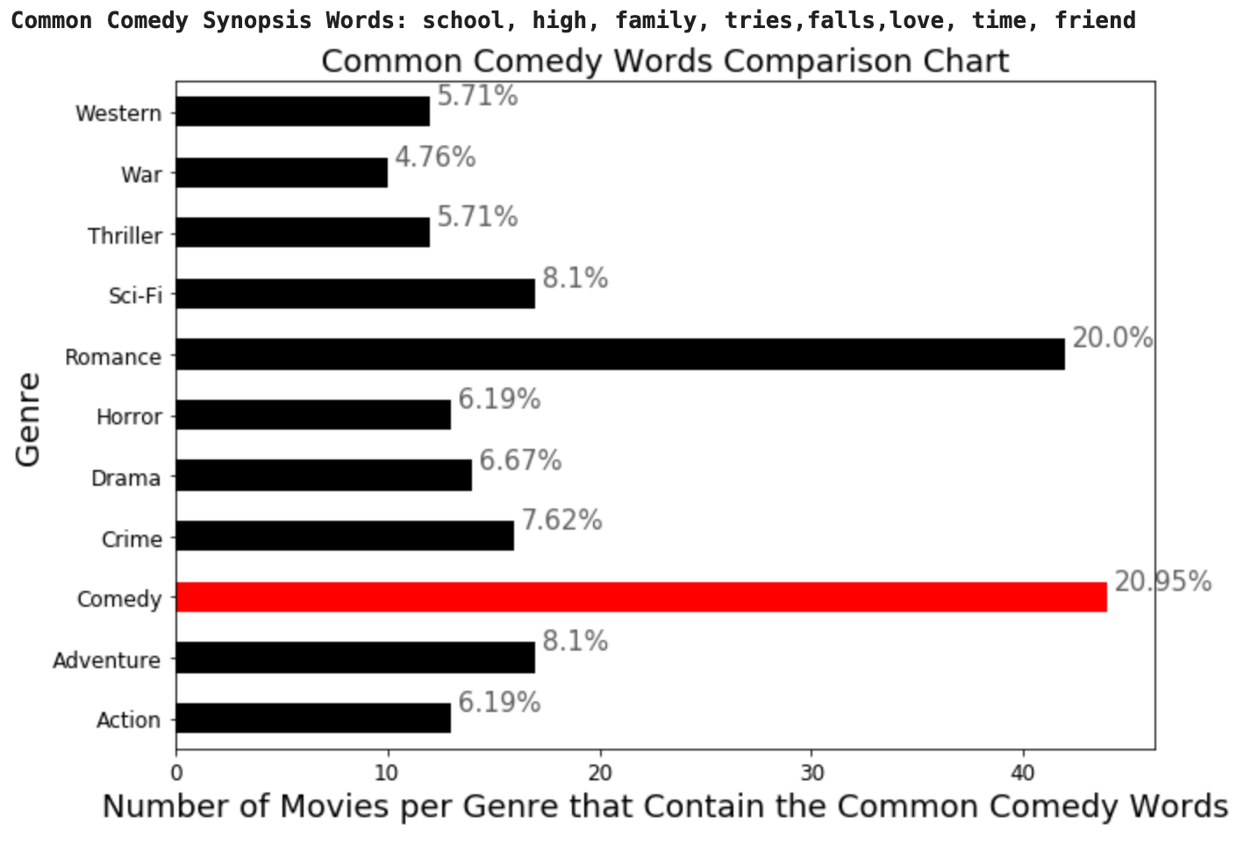
Ensemble Model 2.3 Conclusions - Romance and Comedy
Analysis: Since we used Genre Variations, our model received high F1 scores for Romance and Comedy because there are many movies that are categorized as Comedy and Romance → Rom Com. If we did not use Genre Variations, it would have mispredicted more often for comedy, giving a lower F1 score for comedy.

